Slide 1


Optimizing Marketing Budgets with Machine Learning
Using machine learning to model campaign ROI and optimize budget allocation across multiple marketing channels.
by Abhishek Sharma
Notes:
What is marketing budeget allocation?

Slide 2
Traditional vs. Data-Driven Allocation
Traditional Methods
Data-Driven Approaches
Fixed ratios, neglect consumer behavior changes. (IEEE Xplore 2024)
Machine learning adapts to real-time responsiveness.
(Nuara & Alessandro, 2021).

Slide 3

Framework Components
1
Feature Engineering
2
Automated ML (AutoML)
3
Performance Evaluation
Capture subtle data relationships.
Automate model selection and tune hyperparameters.
Ensure solution generalizes across business settings.
Notes:
Discuss

Slide 4
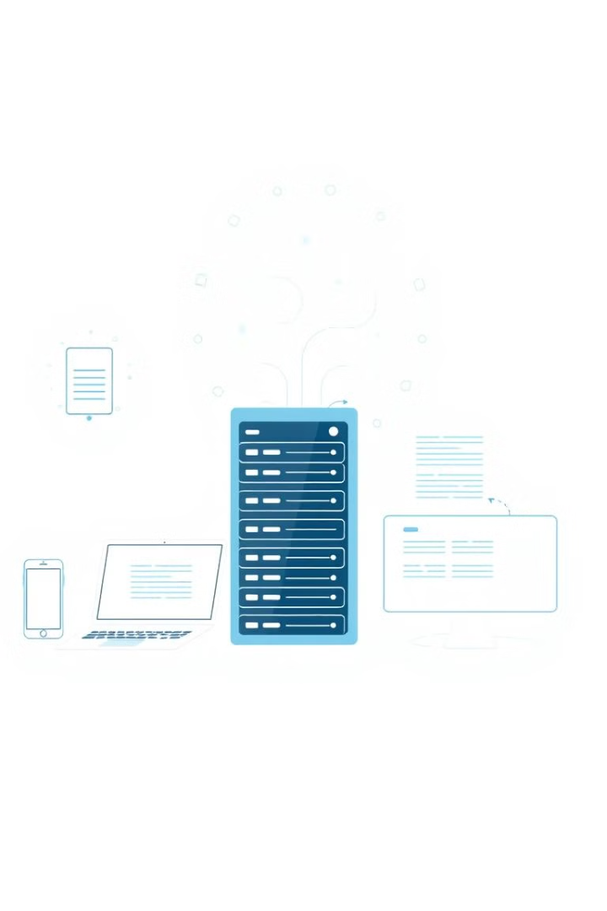
Data Collection and Pre-processing
1
Campaign Details
ID, Company, Campaign Type, Target Audience.
2
Performance Metrics
Conversion Rate, Acquisition Cost, ROI.
3
Additional Attributes
Location, Language, Customer Segment, Launch Date.

Slide 5
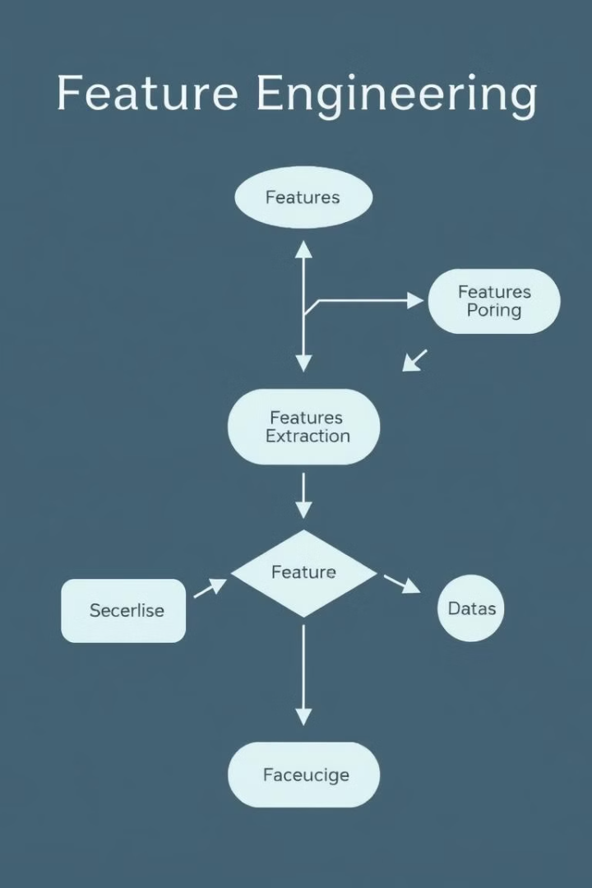



Feature Engineering Highlights
Ratio Features
Temporal Features
Interaction Features
Clicks per Impression, Cost per Click.
Month, Day, Quarter, Day of Week.
Target Audience and Customer Segment.

Slide 6
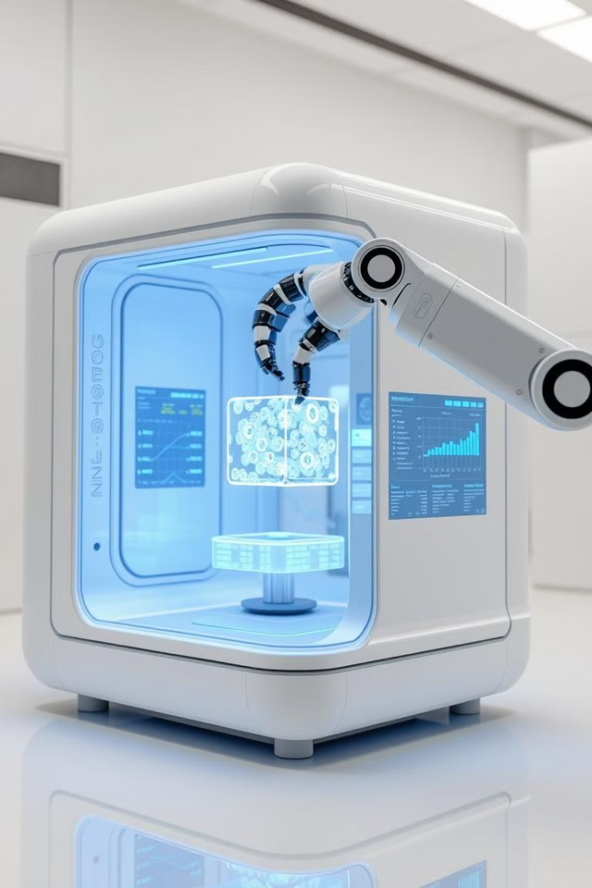



AutoML for ROI Prediction
Regression Task
Target variable set to ROI.
Data Split
80% training, 20% test set.
Feature Encoding
Categorical variables encoded automatically.

Slide 7

Algorithm Performance
Algorithm
RMSE
MAE
R² Score
Voting Ensemble
1.741
1.509
0.00016
ExtremeRandomTrees
1.741
1.509
0.00017
RandomForest
1.741
1.509
0.00016

Slide 8

Evaluation Metrics and Findings
1.512
MAE
Average prediction error.
0.001
R² Score
Limited capture of underlying relationships.

Slide 9
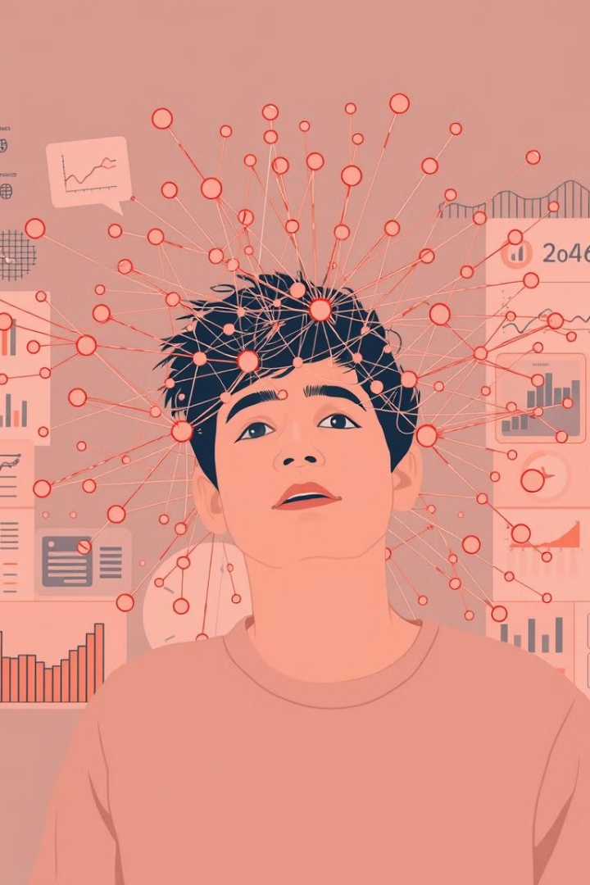
Model Limitations
Low R² Score
Company-Specific Strategies
Limited ability to explain ROI volatility.
One-model-for-all is ineffective.
External Factors
Competitor data, economic indices missing.

Slide 10
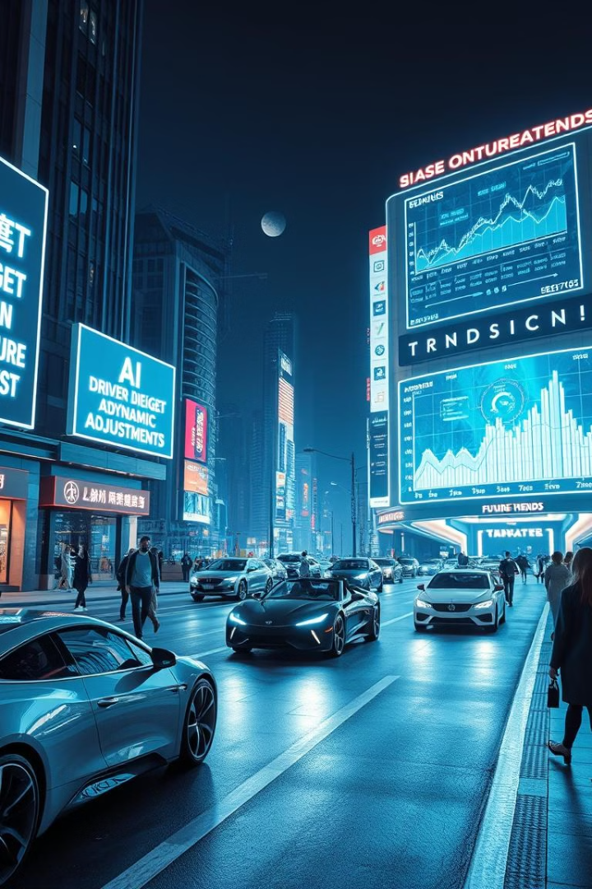
Conclusion and Future Directions
Company-Specific Models
External Factors
Incorporate economic indicators and competitor moves.
Targeted approaches may be more effective.
Real-Time Learning
Dynamic adjustments based on lifestyle changes.

Slide 11
References
Nuara, M., & Alessandro, F. (2021). Data-driven marketing budget allocation: A machine learning approach. Politecnico di Milano.
IEEE Xplore. (2024). AI-powered marketing analytics: Optimizing budget allocation using predictive modeling. IEEE. Retrieved from https://ieeexplore.ieee.org
EBSCO Research. (2024). Machine learning applications in marketing: Enhancing campaign efficiency through AI-driven strategies. EBSCO.
OpenAI. (2024). Generative pre-trained transformer (ChatGPT): For model coding. Retrieved from https://openai.com

